Slide 1

Practical Classes
Chris Piech
CS106A, Stanford University

Slide 2
A class defines a new variable type

Slide 3
You must define three things
1. What variables does each instance store?
2. What methods can you call on an instance?
3. What happens when you make a new one?
*details on how to define these three things coming soon

Slide 4
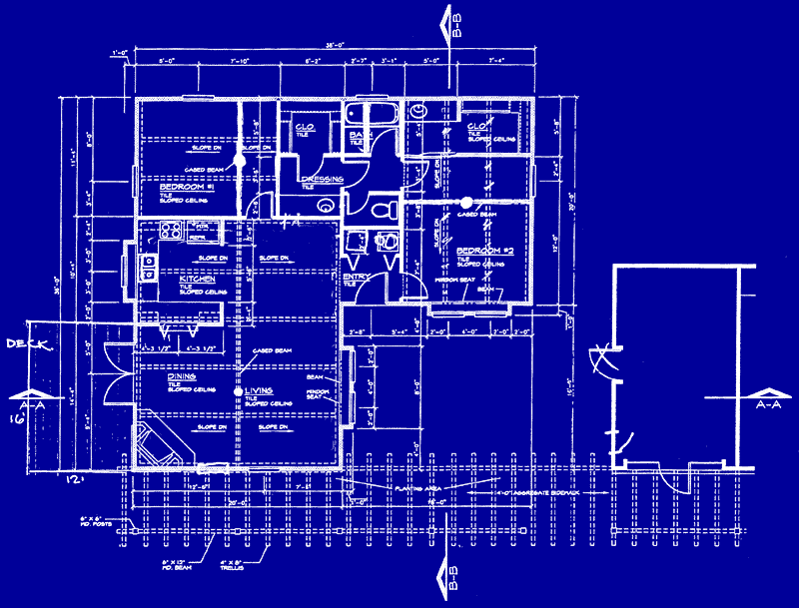

Classes are like blueprints
class: A template for a new type of variable.

Slide 5
What does a class do?

Slide 6
A class defines a new variable type

Slide 7
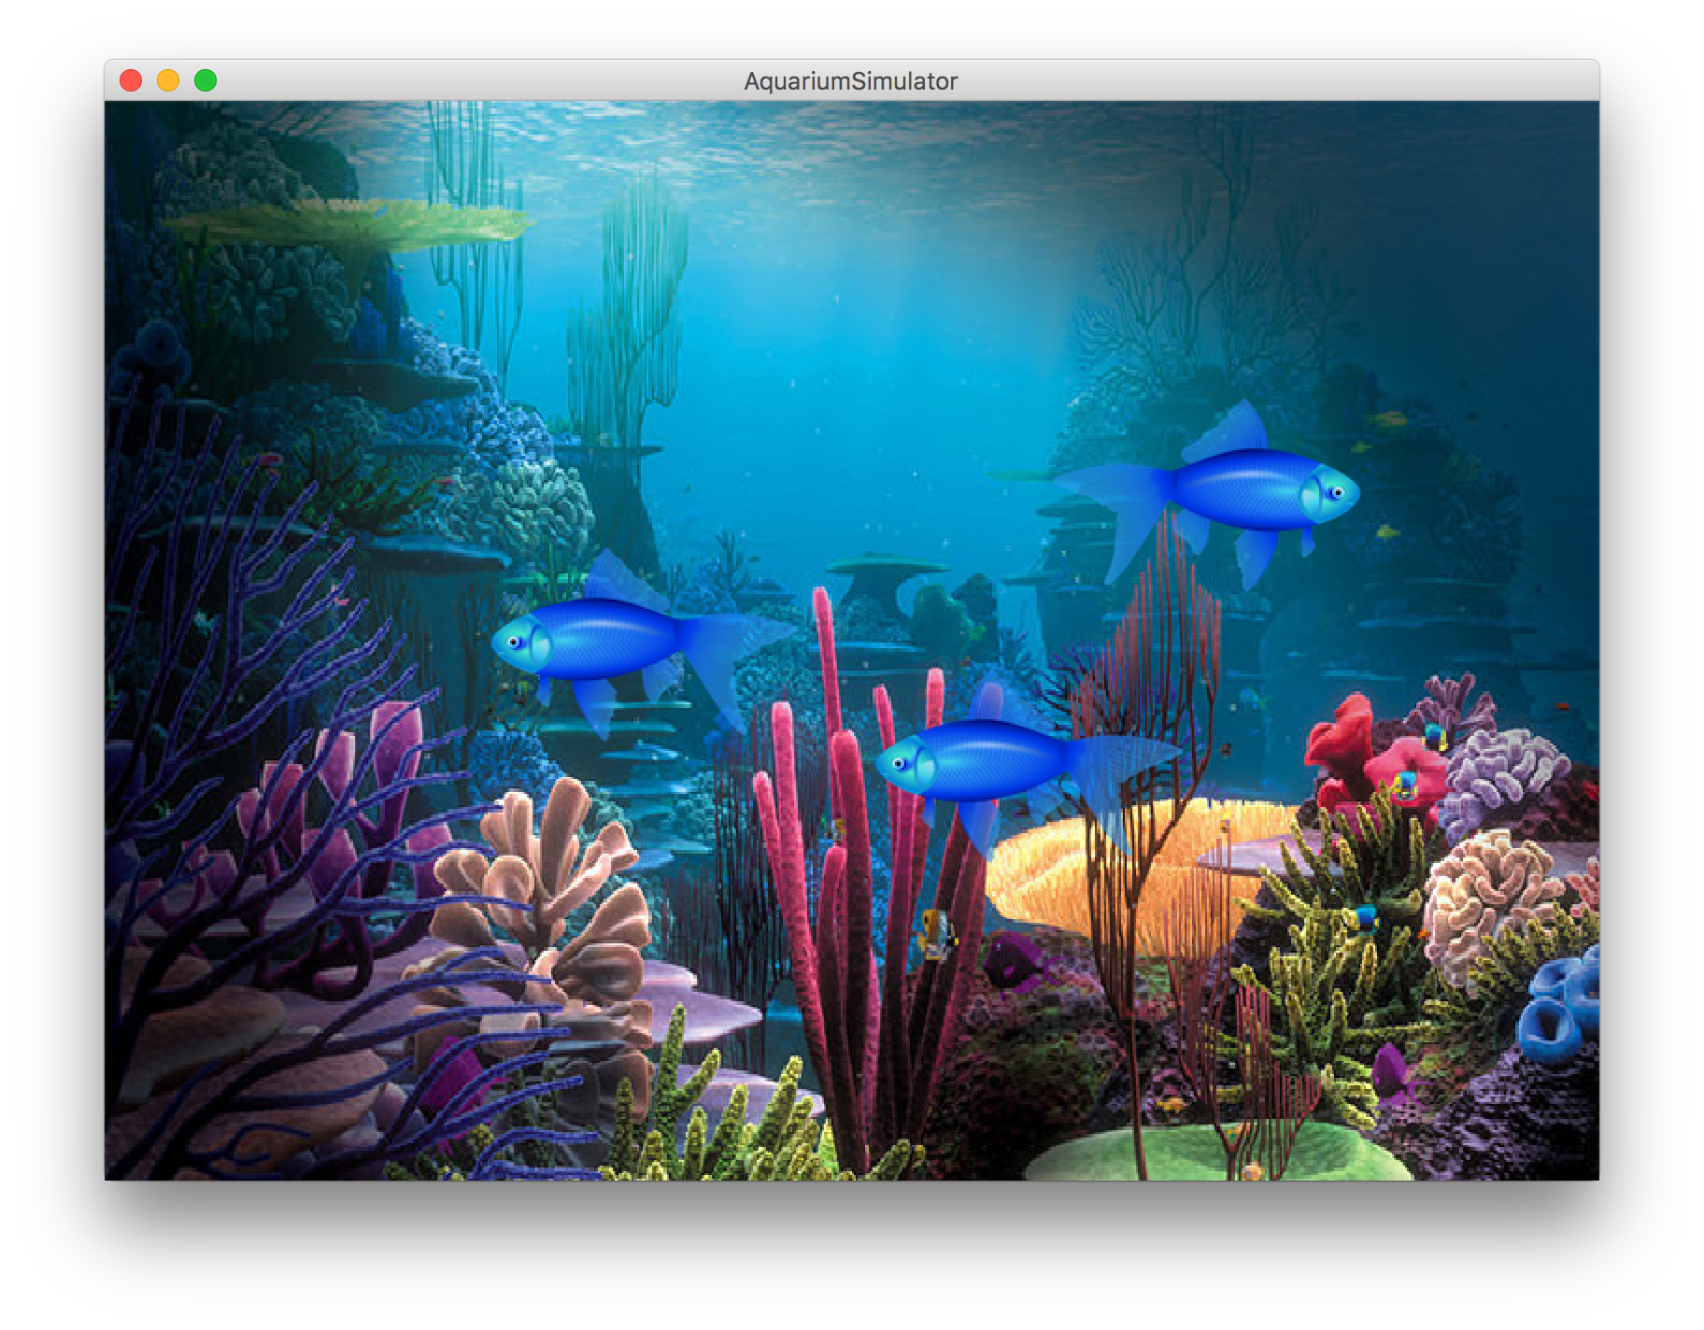
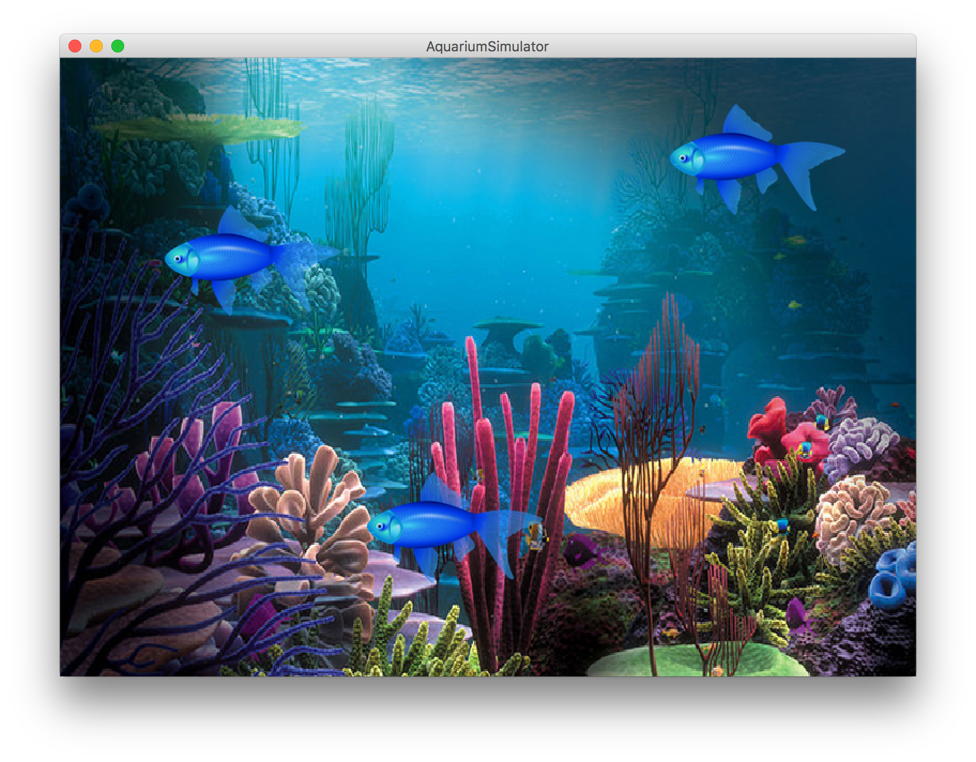

Slide 8
extends
Make a class inherit all the
instance variables and methods
of another class

Slide 9
public class Simulator extends GraphicsProgram {
// class definition
}

